Slide 1

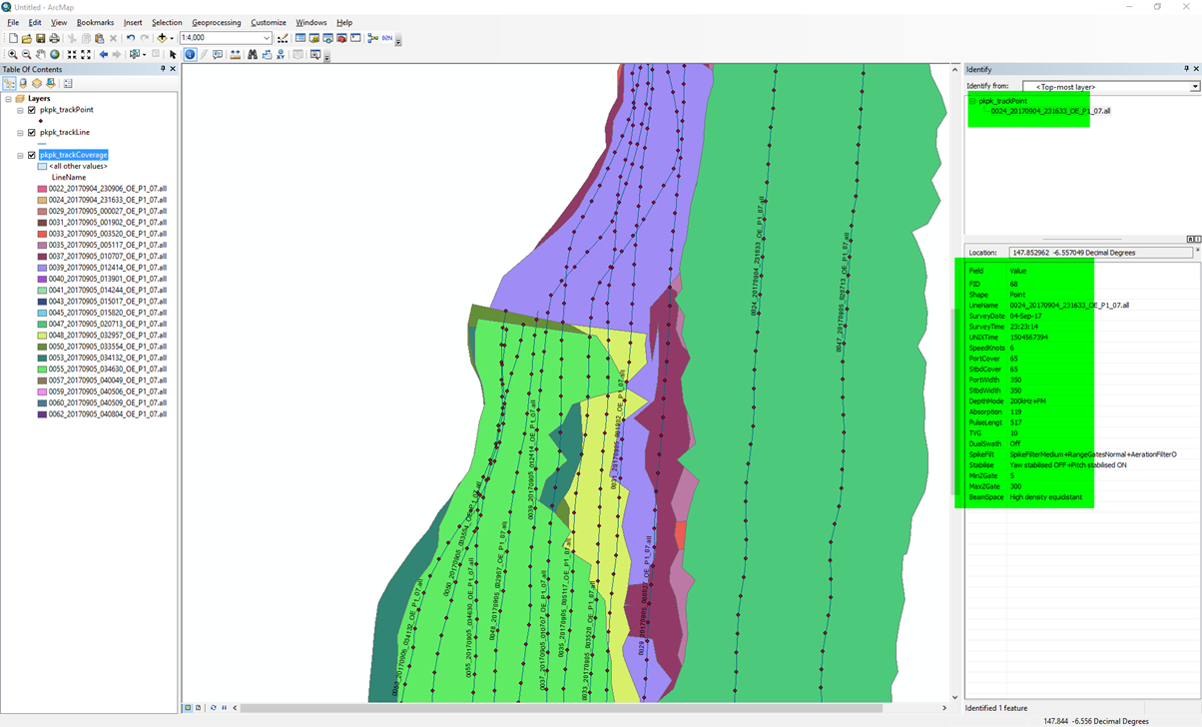
Multibeam Toolbox for ArcGIS
Tools to aid in the integration of Multibeam Surveys with ArcGIS – January 2016

Slide 2
What is the MBES Toolbox?
The toolbox is a set of ESRI compatible ArcGIS scripts which work within the ArcGIS toolbox of ArcMap and ArcCatalog
Permit the rapid generation of track lines, track points and multibeam coverage plots from raw multibeam data
No processing system such as CARIS, Proc, QPS is required to pre-process.
More raw file formats can easily be added
Users can modify the scripts to meet their own requirements.

Slide 3
Why do we need this toolbox?
Clients and management require rapid assessment of production. Linear distance surveyed, overlaps, square kilometres mapped are common requests
On large projects with thousands of raw files, understanding what files are where is not easy without GIS. Regular processing tools struggle. ArcGIS is very efficient in this regards.
Imported vector data is attributed with multiple fields, permitting a better quality control of the survey. When the processed data does not look as expected, the real time user settings will assist in understanding why

Slide 4
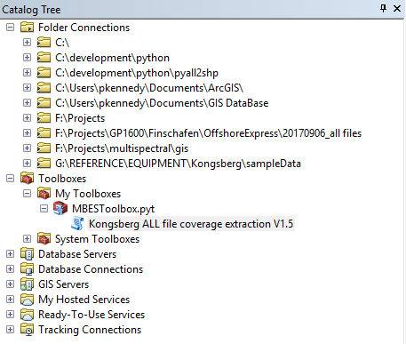
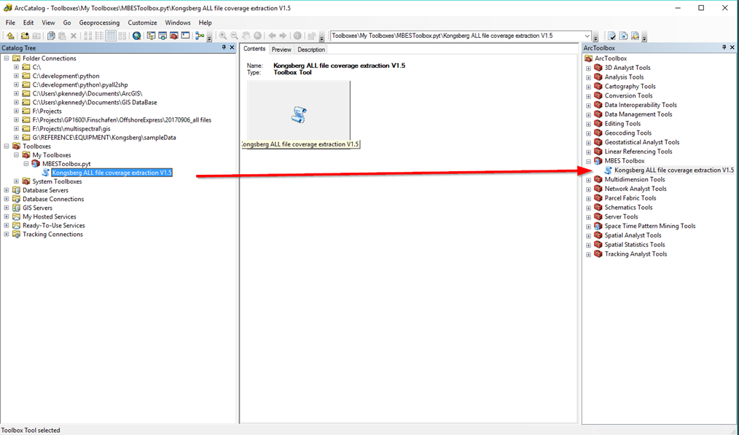
How do we install the toolbox?
The MBES toolbox for is shipped as a zip file Unzip into
C:\Users\<username>\AppData\Roaming\ESRI\Desktop10.4\ArcToolbox\My Toolboxes
(The passwd is ‘zip’)
You can then see it in arccatalog like this. You can then drag and drop into the regular toolbox view.

Slide 5
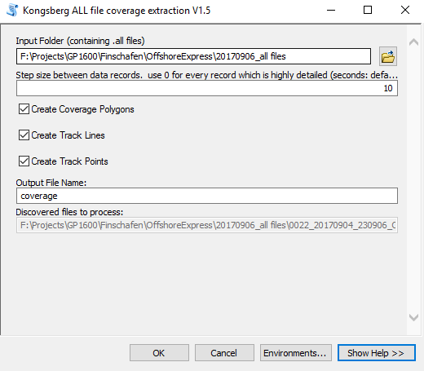
How do we run the toolbox?
Double click to run it. You need to select the FOLDER, not the files. All files in that folder will be scanned. You can see the files it finds in the grey textbox.
Seleect the folder to process. All files within the folder will be processed
The step size defines the interval in seconds between updates in the track and coverage. For small boats use a number such as 5. For large deep water, use a number such as 30
Select the shape file types you wish to create. The coverage takes a little longer than the tracks
Enter a filename prefix here. The files shape will be created into the folder containing the input files.
The files identified to for processing will be displayed here. If there are no files, nothing will be processed
Press OK to create the shape files!

Slide 6
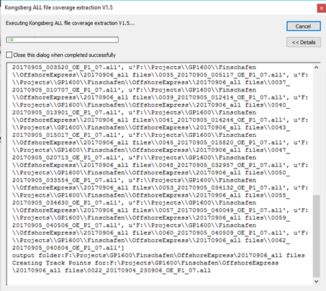
What about progress?
Once you have selected the .all files, you can see them being processed…

Slide 7

What happens after processing?
Once processed, you will have 3 * shp files in the same folder as the .all files, for coverage, track line and track plot. You can then add them into arcmap as you would any layer.
The Coverage plot contains 1 polygon per input file. For each ping, it represents the left and right most observation. This is a very good estimation of the raw coverage.
The Track Line contains 1 polyline per input file. It has a date of survey and input name (line name). It is excellent for labelling the survey lines within ArcMap so we can see where lines reside.
The Track Point contains all important user-configured runtime settings, which we can query with the standard ArcMap identify tool. This is pretty handy as we can rapidly understand why the data is appearing as it does. The TVG, mode, filter and pulse length are very handy for backscatter analysis. For bathymetry, it reports the user defined swath width, mode, real time filters.

